Slide 1


Enhancing Truck Utilization and Route Optimization for Operational Efficiency
DAB400-25W-003
Group 10

Slide 2
Problem Statement
Inefficient Scheduling
Underutilized Trucks
High Operational Costs

Slide 3
Objective
Optimize Schedules
Reduce Fuel Consumed
Maximize Truck Utilization

Slide 4
Data
Truck ID
Mileage (MPG)
Truck Age
Load Capacity
Route ID
Distance
Average Hours
Trucks Table
Routes Table
Schedule Table
Drivers Table
Truck ID
Route ID
Departure Date
Estimated Arrival
Driver ID
Truck ID
Average Speed

Slide 5
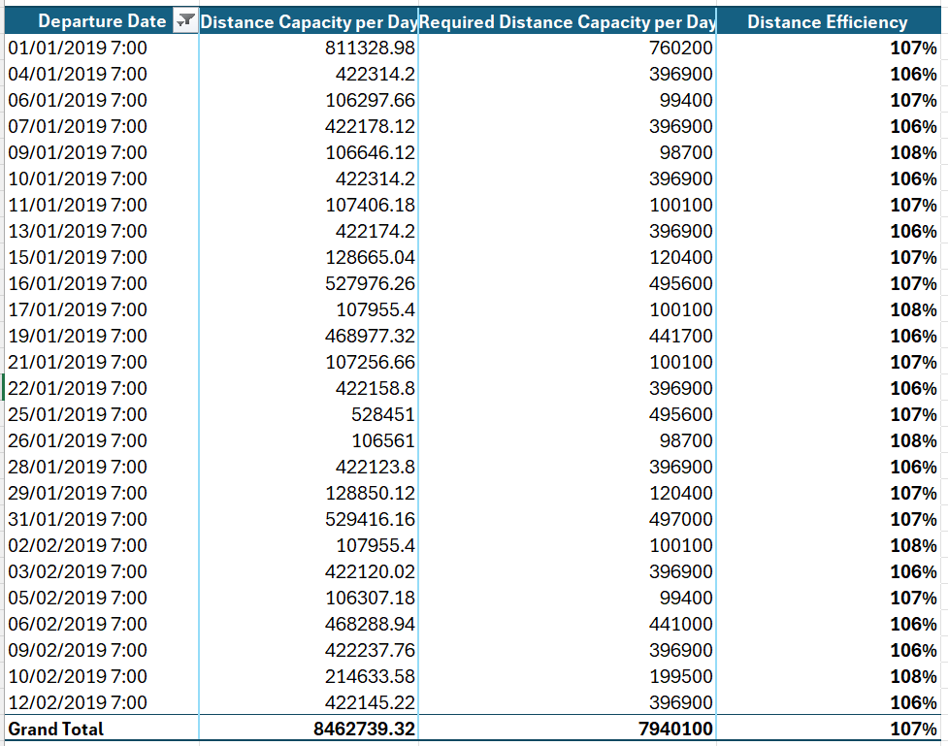
Daily Distance Efficiency
Average Speed
(driver’s)
14 hours
Distance Capacity
Required Speed (50mph)
14 hours
Required Distance Capacity

Slide 6
Route Time Efficiency
Distance
Average Speed (driver’s)
Average Actual Hours
Row Labels | Sum of average hours | Sum of average actual hours | Time Efficiency
R-003c7a81 | 38.08 | 33.65 | 113%
15506849 | 4.76 | 3.59 | 133%
28161729 | 4.76 | 4.64 | 103%
29956808 | 4.76 | 3.94 | 121%
30822651 | 4.76 | 4.39 | 108%
31120899 | 4.76 | 4.51 | 106%
31139762 | 4.76 | 4.88 | 98%
48116553 | 4.76 | 3.83 | 124%
99981667 | 4.76 | 3.87 | 123%
R-0051cd84 | 41.68 | 41.54 | 100%
18273387 | 5.21 | 4.50 | 116%
18441286 | 5.21 | 5.79 | 90%
19486564 | 5.21 | 4.60 | 113%
20792581 | 5.21 | 6.94 | 75%
24803038 | 5.21 | 4.53 | 115%
25017099 | 5.21 | 4.44 | 117%
29006962 | 5.21 | 5.54 | 94%
31534922 | 5.21 | 5.19 | 100%

Slide 7
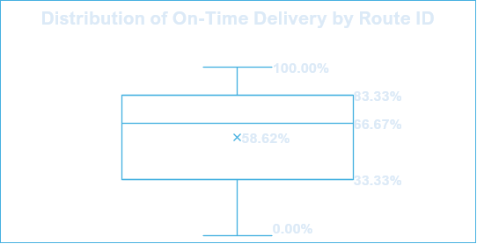
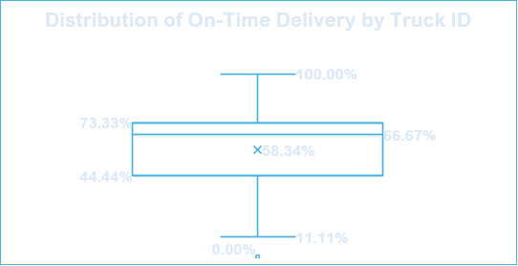
On-Time Delivery
Total On-Time Delivery 64.97%

Slide 8
Observations & Insights

Slide 9
Optimization Phase 1
Calculate total distance for each truck
Group trucks by load capacity and fuel type
Compare trucks within same load capacity but different fuel type
If total distance of gas truck > distance of diesel truck, swap

Slide 10
Results
Original Data
Optimized Data
Name | Value
Average Diesel Consumed for Long Routes | 113.68
Average Gas Consumed for Long Routes | 150.65
Average Diesel Consumed for Short Routes | 22.34
Average Diesel Consumed for Short Routes | 30.47
Name | Value
Average Diesel Consumed for Long Routes | 115.28
Average Gas Consumed for Long Routes | 114.75
Average Diesel Consumed for Short Routes | 26.99
Average Gas Consumed for Short Routes | 29.74
Total Fuel Used (gallons)
703306.78
665346.26

Slide 11
Results
Fuel Optimization Ratio by Load Capacity
Load Capacity (pounds) | Optimization Ratio
3000 | 4.98%
4000 | 5.26%
6000 | 5.57%
10000 | 6.72%
15000 | 5.81%
20000 | 2.90%
Average Optimization Ratio 5.12%

Slide 12
Optimization Phase 2
Group Data by Fuel Type and Load Capacity
Calculate Total Distances for each truck within groups
Compare trucks distances and mpg within groups
Swap trucks with higher mpg to longer routes and vice-versa

Slide 13
Results
Fuel Optimization Ratio by Load Capacity
Load Capacity | Optimization Ratio
3000 | 1.30%
4000 | 1.30%
6000 | 1.22%
10000 | 1.25%
15000 | 1.23%
20000 | 1.29%
Average Optimization Ratio 1.22%

Slide 14
Results
Data Source | Fuel Consumed (gallons)
Original | 703306.78
1st Optimization | 665346.26
2nd Optimization | 656923.65
Total Optimization Ratio | 6.60%

Slide 15





Conclusion
Distance & Time Efficiency Calculated
On-Time Delivery Measured
Two Phases of Optimization Implemented
Fuel Consumption Reduced
Truck Utilization
Improved

Slide 16
Q&A

